Slide 1
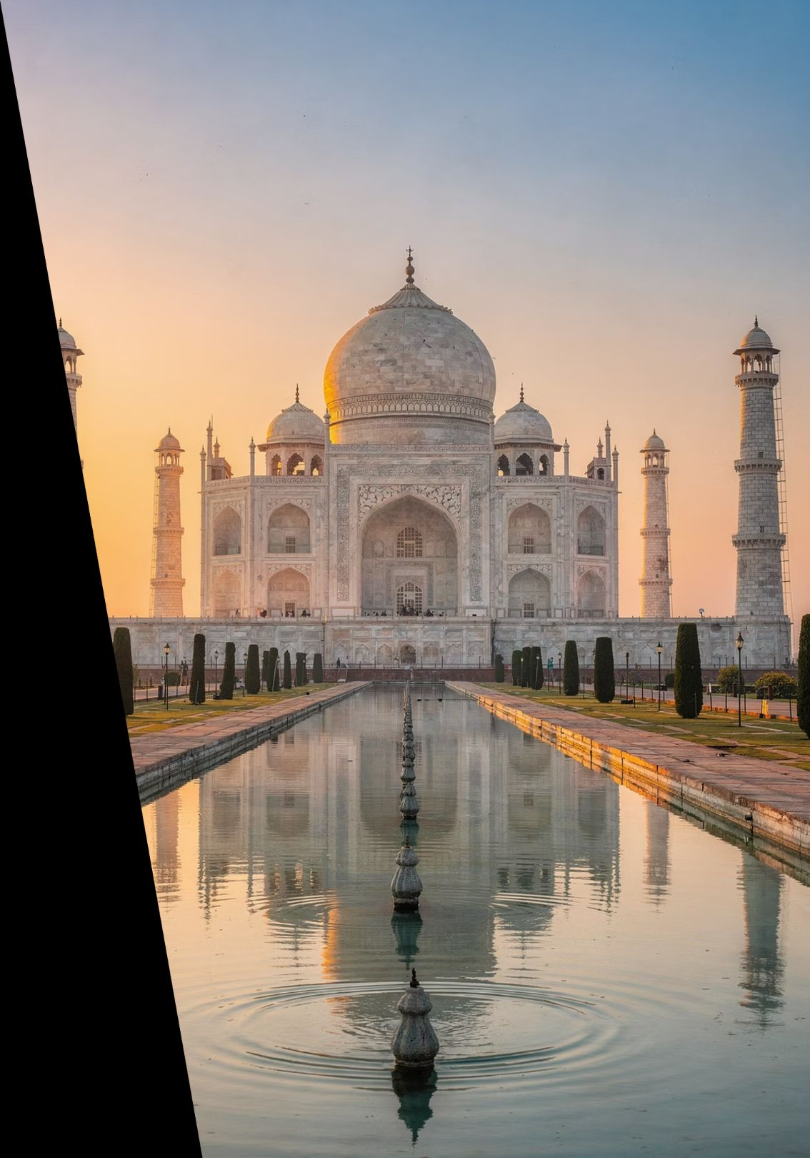
Indian Culture & Heritage Tourism Website
Explore • Learn • Travel • Book
A comprehensive digital platform connecting travellers with India's rich cultural heritage

Slide 2
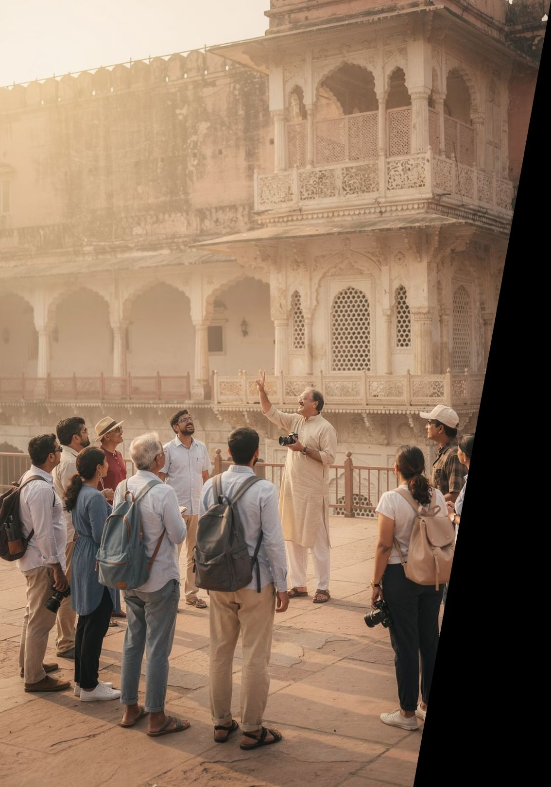
INTRODUCTION
Bridging Heritage and Modern Tourism
India stands as a treasure trove of rich culture, heritage, and ancient traditions that span millennia. Each year, millions of tourists from across the globe journey to experience its magnificence.
Our innovative project addresses this challenge by creating a unified digital platform where tourists can seamlessly explore authentic heritage sites, learn their fascinating histories, and complete their bookings—all in one place.
However, travellers often struggle with fragmented information scattered across countless websites, making trip planning overwhelming and time-consuming.
This solution transforms the complex tourism planning process into an intuitive, engaging experience.

Slide 3

PROJECT VISION
Aim of the Project
Promote Digital Heritage
Comprehensive Information
Showcase India's cultural wealth through an engaging digital platform that reaches global audiences and preserves our heritage for future generations.
Provide detailed, accurate information about heritage destinations including history, architecture, cultural significance, and practical visiting details.
Seamless Booking
User-Friendly Experience
Enable effortless trip planning with integrated booking systems for accommodations, travel packages, and local guides—all from a single interface.
Create an intuitive platform that simplifies tourism planning, making India's heritage accessible to travellers of all experience levels.

Slide 4
Problem Statement
Current tourism planning in India faces several critical challenges that hinder the traveller experience:
Fragmented Information
No Centralized Platform
Heritage site details are scattered across numerous websites, blogs, and platforms, requiring extensive research and verification. Tourists spend hours piecing together basic information.
The absence of a unified tourism portal forces travellers to navigate multiple booking systems, leading to confusion, higher costs, and booking inconsistencies.
Complex Booking Process
Limited Cultural Context
Coordinating hotels, transport, and guided tours separately creates logistical nightmares. Travellers struggle to synchronise bookings and often miss opportunities.
Many platforms lack deep cultural insights and historical context, preventing tourists from fully appreciating the significance of heritage sites they visit.

Slide 5


OUR SOLUTION
A Comprehensive Web-Based Platform
1
Rich Cultural Content
2
Integrated Booking System
Detailed profiles of Indian cultural and heritage places showcasing history, architecture, and cultural importance with stunning photography.
Seamlessly book trips, accommodation, and local guides directly through the platform with real-time availability and instant confirmation.
3
Smart Navigation Tools
4
Visual Storytelling
Interactive maps, optimal visiting times, entry fee information, and detailed directions to help tourists plan efficiently.
Extensive image galleries, virtual previews, and multimedia content that bring heritage sites to life before visitors arrive.

Slide 6
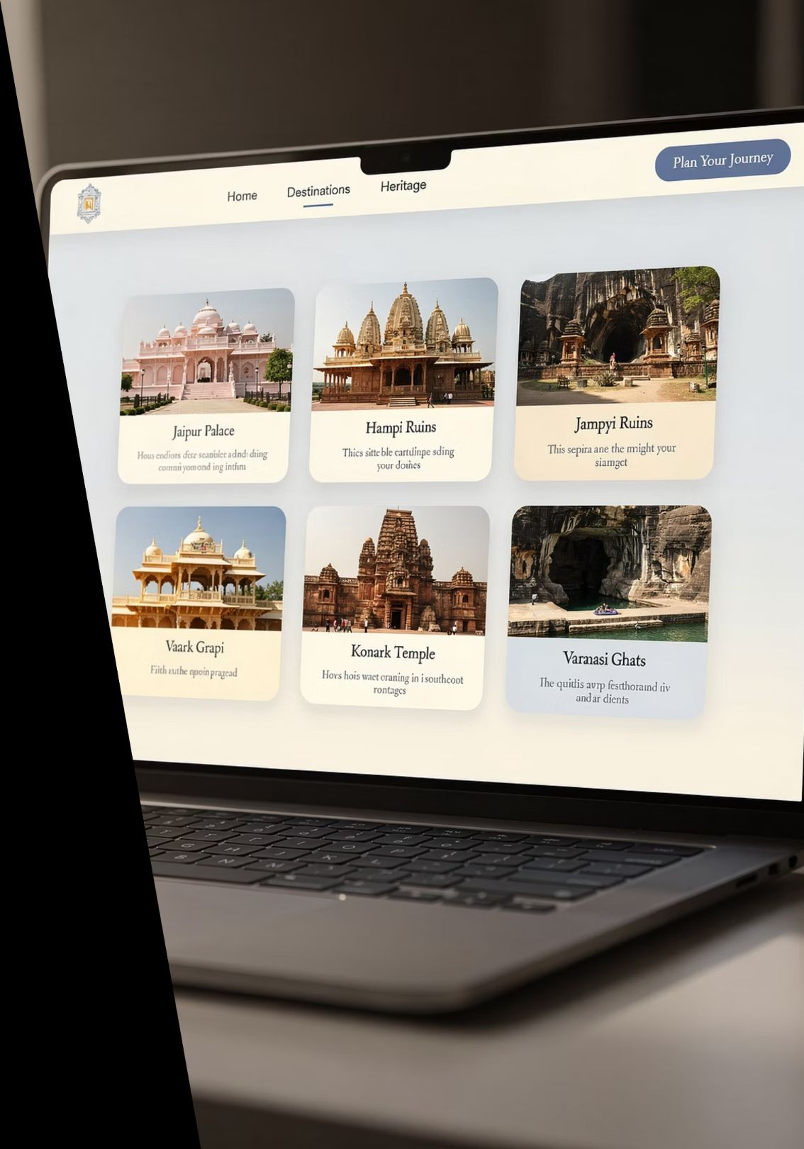



EXPLORE
Discover Heritage Places
Intuitive Browsing
Our explore page presents destinations through an engaging card-based layout, making discovery effortless and enjoyable.
Visual Cards
Each destination features high-quality imagery, name, location, and compelling descriptions
Smart Filters
Refine results by state, heritage type, popularity, and seasonal recommendations
Quick Overview
Ratings, visitor reviews, and key highlights visible at a glance

Slide 7
Place Detail Page
Each heritage site receives a comprehensive, beautifully designed profile page:
Rich Historical Context
Immersive Gallery
Planning Information
Interactive Maps
Detailed narratives covering construction, dynasties, architectural significance, and cultural importance across centuries.
Extensive photo collections showcasing architecture, intricate details, surrounding landscapes, and seasonal variations.
Optimal visiting seasons, weather patterns, crowd levels, entry fees, operating hours, and accessibility details.
Embedded Google Maps with directions, nearby attractions, facilities, parking, and public transport options.

Slide 8

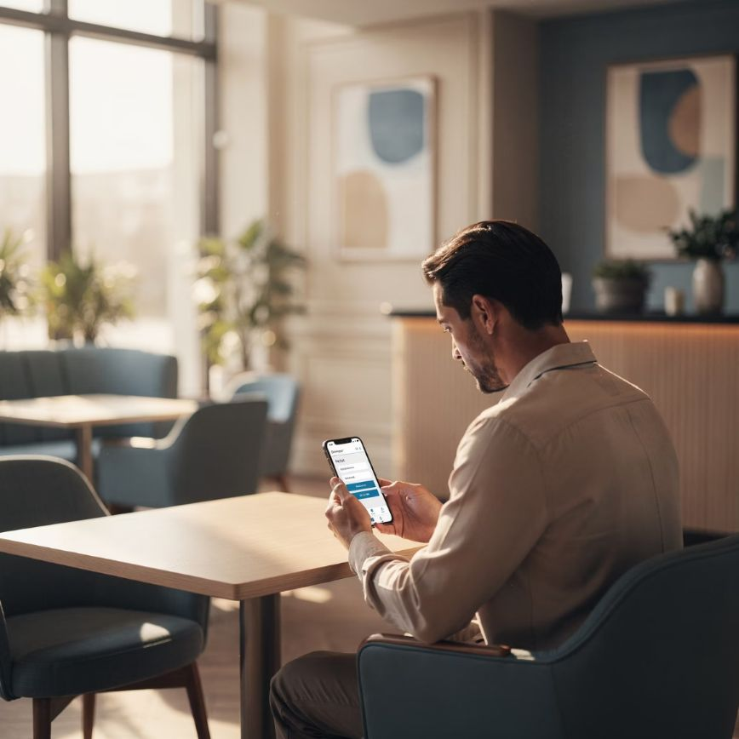
BOOKING SYSTEM
Seamless Trip Booking
Comprehensive Booking Options
Transform your heritage exploration into reality with our integrated booking system that handles every aspect of your journey.
Curated Travel Packages
Pre-designed itineraries combining multiple heritage sites with optimal routing and timing
Accommodation Selection
Partnered hotels ranging from budget to luxury, all verified and located conveniently near attractions
Expert Local Guides
Certified, knowledgeable guides who bring history to life with authentic stories and cultural insights
Simple Booking Form
Select travel dates with calendar integration
Specify number of travellers and requirements
Choose accommodation type and preferences
Add guided tour options
Receive instant booking confirmation

Slide 9









User Features
Personalised experiences designed around your travel preferences and needs:
User Accounts
Secure registration and login system with profile customisation, travel preferences, and personal information management.
Save Favourites
Create personalised wish lists of heritage sites, build custom itineraries, and save preferred hotels and guides for future reference.
Booking History
Access complete records of past and upcoming trips, download booking confirmations, and track your heritage exploration journey.
Reviews & Ratings
Share your experiences through detailed reviews, rate destinations and services, and help fellow travellers make informed decisions.

Slide 10

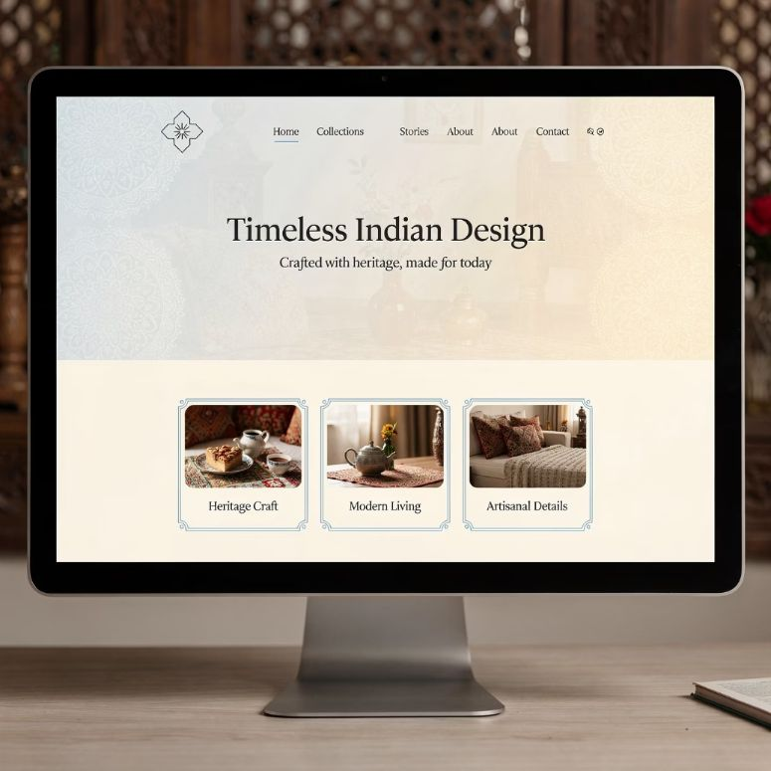

DESIGN
Design & User Interface
Culturally Rich, Technically Modern
Our design philosophy balances traditional Indian aesthetics with contemporary web design principles:
Indian Cultural Theme
Colour palette inspired by Indian heritage: saffron, peacock blue, sandstone, and terracotta
Modern Clean Layout
Uncluttered interfaces with generous white space and clear visual hierarchy
Fully Responsive
Optimised for all devices—desktops, tablets, and smartphones with consistent experience
Smooth Interactions
Fluid animations, seamless transitions, and intuitive navigation enhance user engagement

Slide 11
Technologies Used
Frontend Layer
1
HTML5, CSS3, JavaScript
React framework for dynamic, component-based architecture ensuring fast, interactive user experiences
2
Backend Layer
Node.js / Python
Database
3
Flask or Django frameworks handling server logic, authentication, and database operations efficiently
MySQL / MongoDB
Robust data storage for user accounts, heritage site information, bookings, and reviews
4
Integration
Google Maps API
Deployment
5
Location services, interactive maps, and directions for seamless navigation
GitHub Pages / Cloud Hosting
Reliable hosting with continuous deployment and scalable infrastructure

Slide 12





ENHANCED FEATURES
Additional Features
Festival Calendar
Multi-Language Support
Discover cultural festivals, local celebrations, and auspicious dates aligned with heritage sites. Plan visits around vibrant festivities for enriched experiences.
Interface available in English, Hindi, Telugu, and more regional languages, ensuring accessibility for domestic and international tourists alike.
AI Travel Assistant
Social Sharing
Intelligent chatbot providing instant answers to tourist queries, personalised recommendations, and 24/7 support throughout your journey.
Share favourite destinations, trip itineraries, and travel experiences directly to social media platforms, inspiring others to explore India's heritage.

Slide 13

Key Advantages
1
2
3
Unified Tourism Hub
Time & Effort Savings
Global Cultural Promotion
All heritage exploration and booking needs addressed through a single, comprehensive platform—no more juggling multiple websites.
Streamlined planning process reduces trip preparation from days to hours with integrated tools and curated information.
Digital platform amplifies India's cultural heritage on the world stage, attracting international tourists and cultural enthusiasts.
4
5
Economic Impact
Enhanced User Experience
Supports local tourism ecosystems, heritage site maintenance, and community livelihoods through increased visitor engagement.
Intuitive design and comprehensive information empower tourists to make informed decisions and create memorable journeys.

Slide 14

FUTURE VISION
Future Enhancements
Our roadmap includes exciting innovations to further elevate the platform:
Secure Payment Integration
Complete online payment gateway supporting multiple methods—credit cards, UPI, digital wallets—with robust security protocols and instant transaction confirmations.
AI-Powered Recommendations
Machine learning algorithms analyse user preferences, past bookings, and trending destinations to suggest personalised itineraries perfectly matched to individual interests.
Virtual Reality Tours
Immersive AR/VR experiences allowing users to virtually explore heritage sites before visiting, with 360° views, interactive historical reconstructions, and guided virtual walks.
Mobile Applications
Native iOS and Android apps with offline capabilities, location-based notifications, and enhanced mobile-specific features for on-the-go travellers.
Expanded Language Support
Addition of more regional and international languages, making the platform accessible to broader audiences and promoting inclusive tourism across diverse communities.

Slide 15
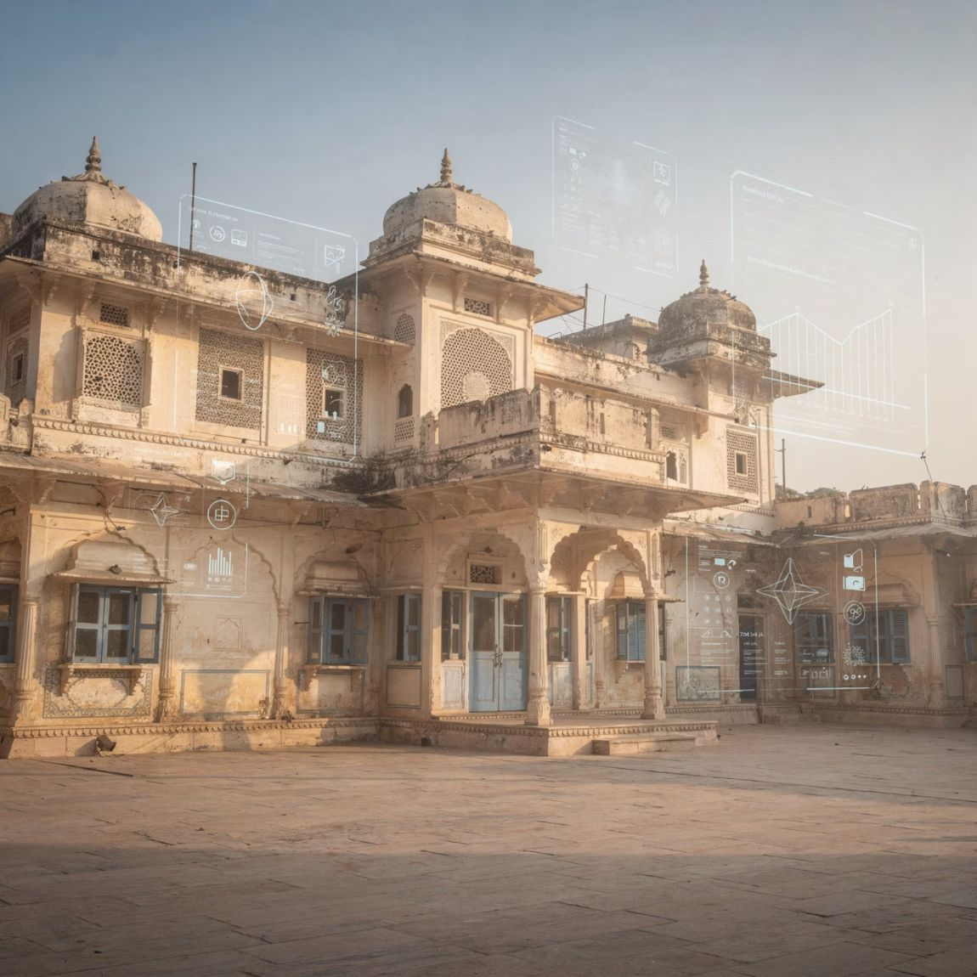
Conclusion
Bridging Culture and Technology
This project represents more than a website—it's a digital gateway to India's soul, connecting generations of heritage with modern technology.
By simplifying tourism planning and providing authentic cultural context, we empower travellers to explore India with confidence and depth.
The platform encourages cultural awareness, supports heritage preservation, and contributes to sustainable tourism growth across the nation.
"A complete digital tourism solution that honours the past while embracing the future."

Slide 16

1
100+
24/7
Unified Platform
Heritage Sites
Support
Single destination for all tourism needs
Comprehensive coverage across India
Always available assistance
Thank You
Questions and feedback welcome
Connecting travellers with India's magnificent heritage, one click at a time.

Slide 17
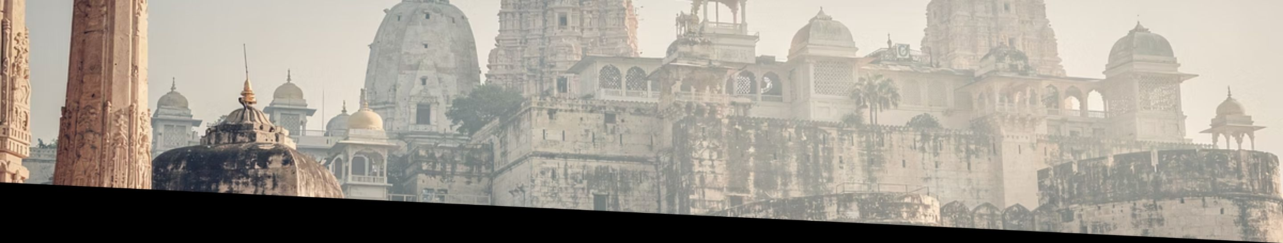
Explore India's Heritage
This presentation showcased our comprehensive web platform designed to revolutionise heritage tourism in India through thoughtful technology integration and user-centric design.
Connect
Explore
Contribute
Contact us for more information about the project and future collaboration opportunities.
Visit our prototype website to experience the platform's features firsthand.
Join us in promoting India's rich cultural heritage through digital innovation.

